Slide 1

Individual Concept Design Review
By:
Natalie Gonzalez

Slide 2





Agenda
Problem Statement
Existing Design
New Design
Requirements
Questions
Notes:
Ian Slide

Slide 3

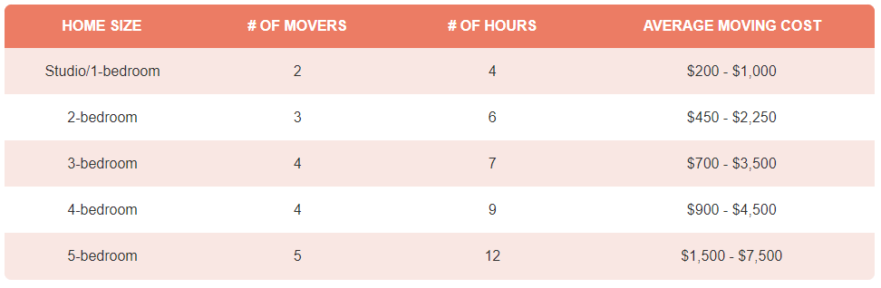
Review of the Problem Statement [1]
Transporting heavy furniture up and down the stairs is difficult and potentially dangerous
Notes:
https://www.forbes.com/home-improvement/moving-services/movers-and-packers-cost/

Slide 4

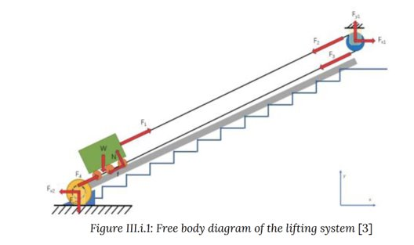
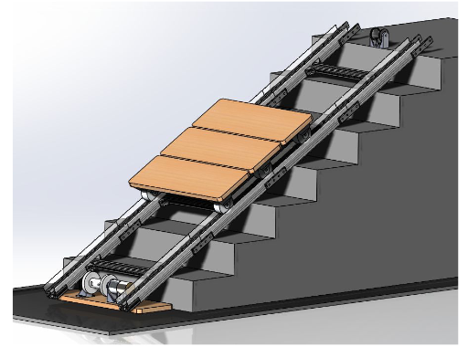
Existing Designs: Portable Stair Lift System [2]
Portable Stair Lift System
Notes:
Natalie Slide

Slide 5
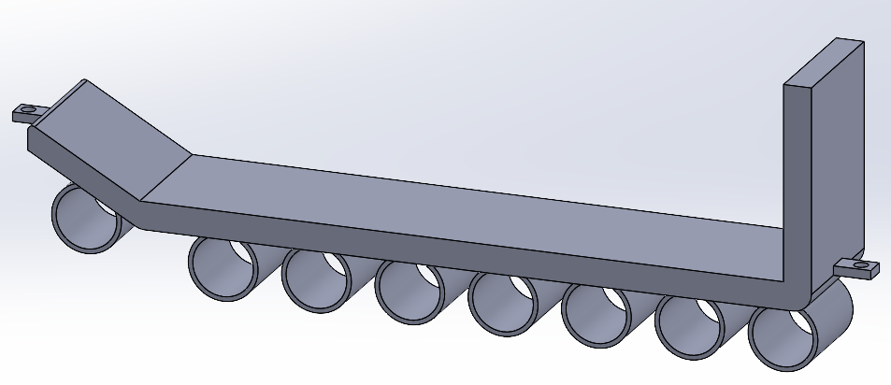

Sled
Pulley Rope Attachment
Lifted Section
Free rotating cylinders
Angle Bottom

Slide 6
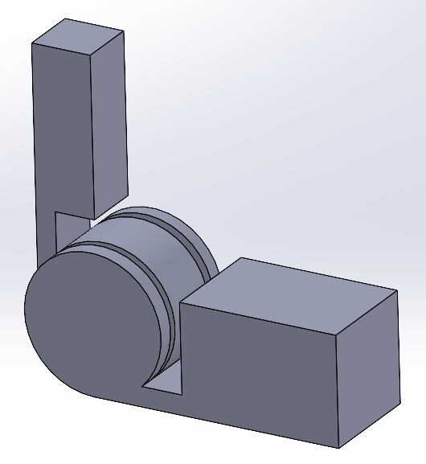
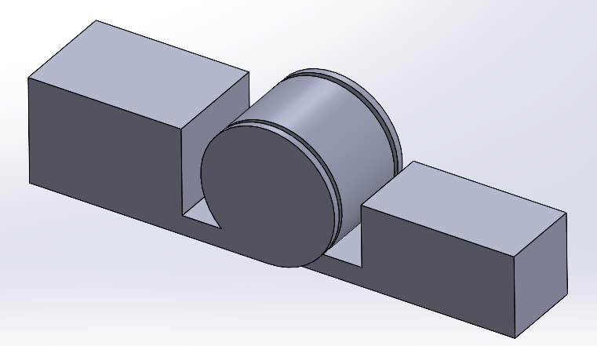
Rail and Joint designs
Small Joint
Large Joint

Slide 7
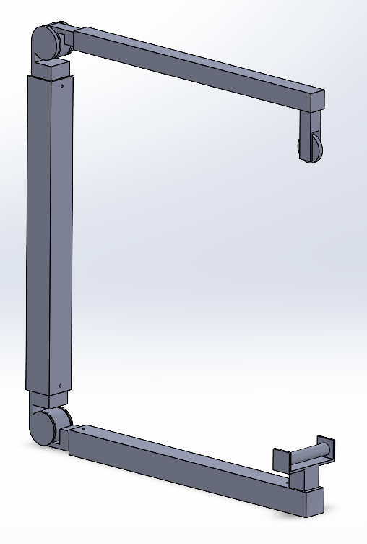
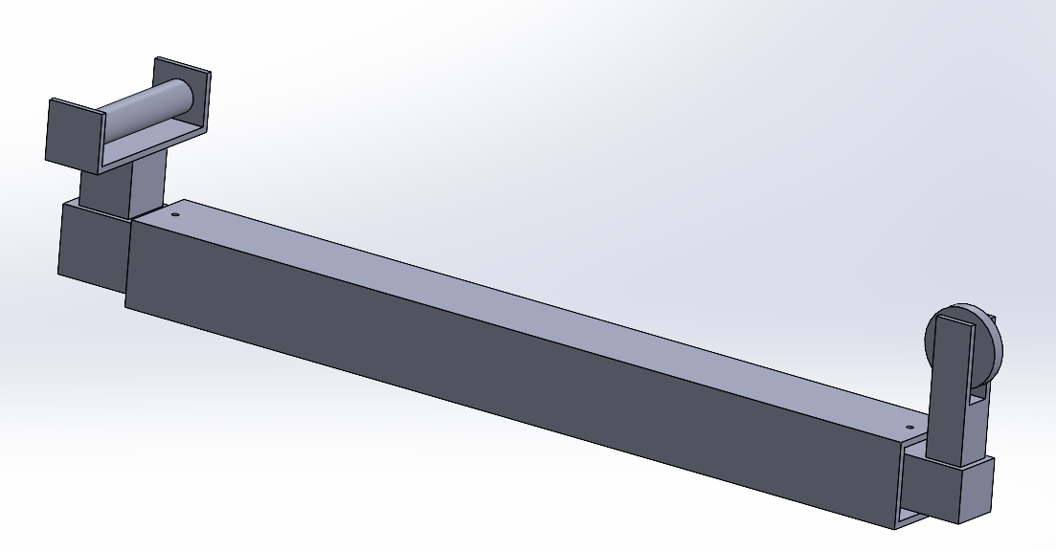
Rail and Joint designs
Hole for locking pins
Folded Rail Configuration
Stacked Rail Configuration

Slide 8
System Flowchart
ON/OFF
Input
Drive Winch Forward
Drive Winch Backward
Sensor
STOP
Wall

Slide 9
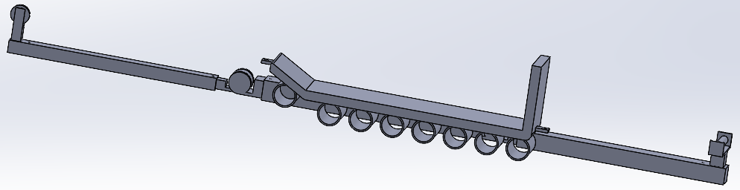
Rail and Joint designs
Pulley Rail
Small Joint
Sled
Winch Rail

Slide 10

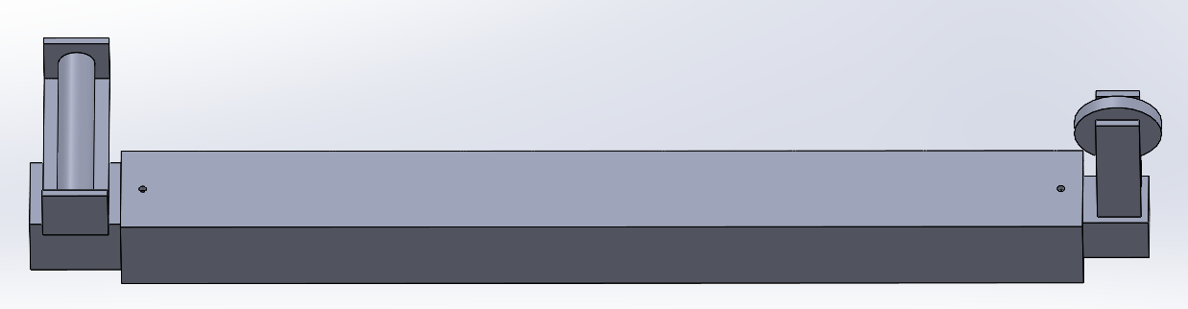
Safety
1. The system shall not destructively alter the environment.
2. The system shall not damage the furniture.
3. The system shall cause less damages than manual moving.

Slide 11
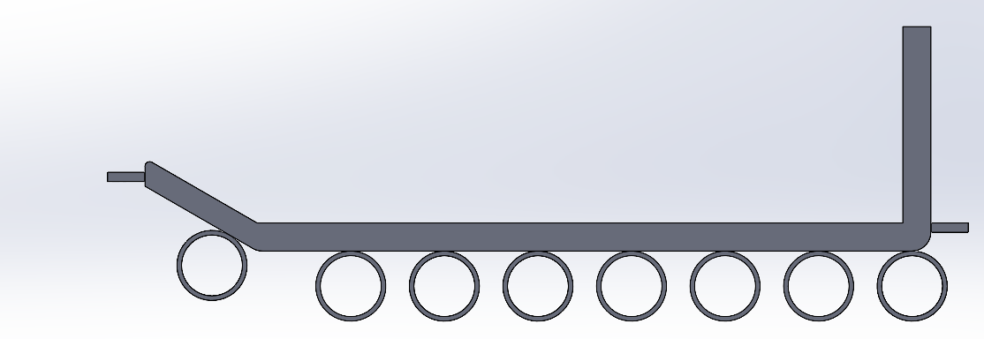
Function
4. The system shall transport furniture repeatedly up and down one floor within a residential building.
5. The system shall be reusable.
Lifted Section
Cylinder offset

Slide 12
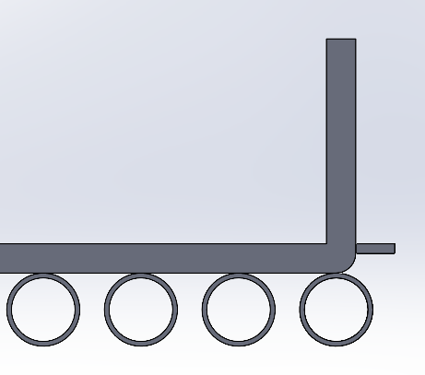
Function
6. The system shall accommodate up to a 4-seater sofa.
7. The system shall accommodate up to a 5-shelf bookshelf
Back Stop

Slide 13
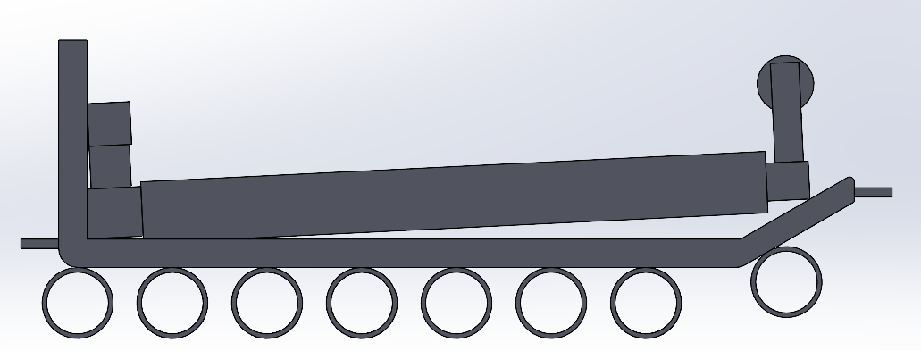
Interfacing
8. The system shall be adaptable to different building layouts.
9. The system shall be transportable in the back of a moving truck.
Stacked Rail
Sled

Slide 14
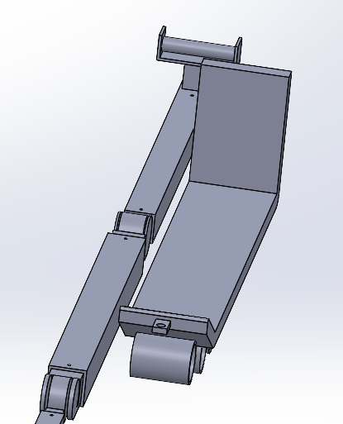
Interfacing
10. The system shall fit within a standard of the 2021 International Residential Code.

Slide 15

Questions?

Slide 16
Bibliography
A. Ogletree, “How Much Do Movers Cost In 2023?,” Forbes Home. Accessed: Sep. 24, 2023. [Online]. Available: https://www.forbes.com/home-improvement/moving-services/movers-ad-packers-cost/
M. B. ME, “Portable Stair Lift System,” PhD Thesis, WORCESTER POLYTECHNIC INSTITUTE, 2021.​

